Slide 1

Introduction to Packer Templates
New Video File

Slide 2





Writing Packer Templates

Slide 3

Packer Templates
The core functionality and behavior of HashiCorp Packer is defined by a template
Templates consist of declarations and command, such as what plugins (builders, provisioners, etc.) to use, how to configure the plugins, and what order to run them
Packer templates support two formats
HCL2
(HashiCorp Configuration Language)
{ JSON }
This course focuses on writing Packer templates using the HCL2 format

Slide 4



Packer Templates
The Future of Packer is Now
Mighty Fine Design
Look Familiar?
HashiCorp is moving to HCL2 as the standard format for Packer 1.7+
HCL is designed to strike a balance between human-readable and machine-parsable
If you have Terraform experience, Packer templates are going to look very familiar
JSON was previously the standard format
Packer templates are very easy to develop and read
HCL is the same configuration language as Terraform and other HashiCorp products
Note: JSON templates will enter a legacy support phase before being deprecated

Slide 5
HCL Formatting
Configuration format is VCS friendly
(multi-line lists, trailing commas, auto-formatting)
Only code blocks built into the HCL language are available for use
Packer uses a standard file name for simplicity
<name>pkr.hcl
Uses Syntax Constructs like Blocks and Arguments
New features will only be implemented for the HCL format moving forward

Slide 6
HCL Syntax
syntax.pkr.hcl
<BLOCK TYPE> "<BLOCK LABEL>" "<BLOCK LABEL>" {
<IDENTIFIER> = <EXPRESSION>
<IDENTIFIER> = <EXPRESSION>
<IDENTIFIER> = <EXPRESSION>
}
<BLOCK TYPE> "<BLOCK LABEL>" "<BLOCK LABEL>" {
<IDENTIFIER> = <EXPRESSION>
<IDENTIFIER> = <EXPRESSION>
<IDENTIFIER> = <EXPRESSION>
}
<BLOCK TYPE> "<BLOCK LABEL>" "<BLOCK LABEL>" {
<IDENTIFIER> = <EXPRESSION>
<IDENTIFIER> = <EXPRESSION>
<IDENTIFIER> = <EXPRESSION>
}
Block
Arguments
Arguments
Arguments

Slide 7

HCL File Structure
Build all templates in a directory
.
├── README.md
├── ubuntu.pkr.hcl
├── centos.pkr.hcl
├── rhel.pkr.hcl
├── web-app.pkr.hcl
├── prod.pkrvars.hcl
Terminal
$ packer build /opt/packer/templates
Build using a single template
Terminal
$ packer build rhel.pkr.hcl

Slide 8
HCL Example
source "amazon-ebs" "aws-example" {
ami_name = "${var.ami_name}"
instance_type = "t3.medium"
region = "us-east-1"
source_ami_filter {
filters = {
name = "${var.source_ami_name}"
root-device-type = "ebs"
virtualization-type = "hvm"
}
owners = ["amazon"]
}
ssh_username = "ec2-user"
subnet_id = "${var.subnet_id}"
tags = {
Name = "${var.ami_name}"
}
vpc_id = "vpc-1234567890"
}
build {
sources = ["source.amazon-ebs.autogenerated_1"]
provisioner "file" {
destination = "/tmp"
source = "files"
}
provisioner "shell" {
script = "scripts/setup.sh"
}
provisioner "shell" {
script = "scripts/vault.sh"
}
}

Slide 9
JSON Example
{
"variables": {
"ami_prefix": "amzn2",
"ami_name": "{{user `ami_prefix`}}-{{user `app_name`}}-ent-{{user `consul_version`}}-{{timestamp}}",
"region": "us-east-1",
"vpc_id": "vpc-1234567890",
"subnet_id": "subnet-1234567890",
"ssh_username": "ec2-user",
"source_ami_name": "amzn2-ami-hvm-2.0.20200304.0-x86_64-gp2",
"source_ami_owner": "amazon"
},
"builders": [{
"type": "amazon-ebs",
"region": "{{user `region`}}",
"vpc_id": "{{ user `vpc_id`}}",
"subnet_id": "{{ user `subnet_id`}}",
"source_ami_filter": {
"filters": {
"virtualization-type": "hvm",
"name": "{{user `source_ami_name`}}",
"root-device-type": "ebs"
},
"owners": ["{{user `source_ami_owner`}}"]
},
"tags": {
"Name": "{{user `ami_name`}}"
}
}],
"provisioners": [
{
"type": "file",
"source": "files",
"destination": "/tmp"
},
{
"variables": {
"ami_prefix": "amzn2",
"ami_name": "{{user `ami_prefix`}}-{{user `app_name`}}-ent-{{user `consul_version`}}-{{timestamp}}",
"region": "us-east-1",
"vpc_id": "vpc-1234567890",
"subnet_id": "subnet-1234567890",
"ssh_username": "ec2-user",
"source_ami_name": "amzn2-ami-hvm-2.0.20200304.0-x86_64-gp2",
"source_ami_owner": "amazon"
},
"builders": [{
"type": "amazon-ebs",
"region": "{{user `region`}}",
"vpc_id": "{{ user `vpc_id`}}",
"subnet_id": "{{ user `subnet_id`}}",
"source_ami_filter": {
"filters": {
"virtualization-type": "hvm",
"name": "{{user `source_ami_name`}}",
"root-device-type": "ebs"
},
"owners": ["{{user `source_ami_owner`}}"]
},
"tags": {
"Name": "{{user `ami_name`}}"
}
}],
"provisioners": [
{
"type": "file",
"source": "files",
"destination": "/tmp"
},
{
"variables": {
"ami_prefix": "amzn2",
"ami_name": "{{user `ami_prefix`}}-{{user `app_name`}}-ent-{{user `consul_version`}}-{{timestamp}}",
"region": "us-east-1",
"vpc_id": "vpc-1234567890",
"subnet_id": "subnet-1234567890",
"ssh_username": "ec2-user",
"source_ami_name": "amzn2-ami-hvm-2.0.20200304.0-x86_64-gp2",
"source_ami_owner": "amazon"
},
"builders": [{
"type": "amazon-ebs",
"region": "{{user `region`}}",
"vpc_id": "{{ user `vpc_id`}}",
"subnet_id": "{{ user `subnet_id`}}",
"source_ami_filter": {
"filters": {
"virtualization-type": "hvm",
"name": "{{user `source_ami_name`}}",
"root-device-type": "ebs"
},
"owners": ["{{user `source_ami_owner`}}"]
},
"tags": {
"Name": "{{user `ami_name`}}"
}
}],
"provisioners": [
{
"type": "file",
"source": "files",
"destination": "/tmp"
},

Slide 10
Converting Old Templates to HCL
If you have older, JSON formatted templates, you can easily convert them using the packer hcl2_upgrade command
All fields of builders, provisioners and post-processors have a 1:1 correspondence with a few exceptions.
{ JSON }
Template
hcl2_upgrade
HCL2
Template

Slide 11
HCL Syntax
New Video File

Slide 12
HCL Syntax

Slide 13
Block Organization
In general, the ordering of root blocks is not significant within a Packer template since Packer uses a declarative model. References to other resources do not depend on the order they are defined.
Blocks can even span multiple Packer template files.
The order of provisioner or post-processor blocks within a build is the only major feature where block order matters.
Source Block
Build Block
Order of blocks within a template is not significant
Source Block
Build Block

Slide 14
Commenting in HCL2
HCL2
HCL2 supports comment to use throughout your configuration file
# - single line comment
// - single line comment
/* and */ - start and stop delimiters – might span over multiple lines
Terminal
Terminal
# this is a comment
source "amazon-ebs" "example" {
ami_name = "abc123"
}
// this is also a comment
/* <-this is a multi-line comment
source "amazon-ebs" "example" {
ami_name = "abc123"
}
*/
variable "example" {
Everything in green is commented out here

Slide 15
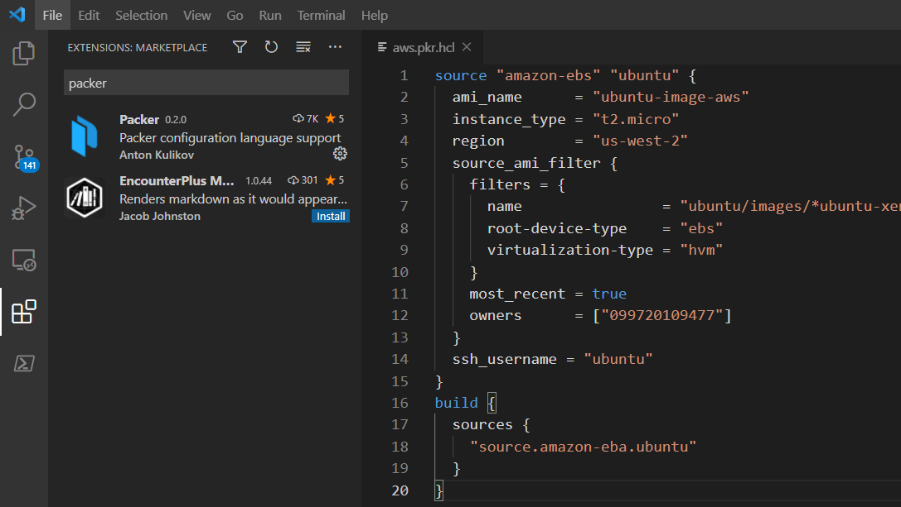
Syntax Highlighting
Plugins for HCL exist for most major editors.
VS Code Extension for Packer adds syntax support for the Packer HCL configuration language.

Slide 16
Interpolation Syntax
source "amazon-ebs" "amazon-ebs-amazonlinux-2" {
ami_description = "Vault - Amazon Linux 2"
ami_name = "vault-amazonlinux2"
ami_regions = ["us-east-1"]
ami_virtualization_type = "hvm"
associate_public_ip_address = true
force_delete_snapshot = true
force_deregister = true
instance_type = "m5.large"
region = var.aws_region
source_ami = data.amazon-ami.amazon-linux-2.id
tags = {
Name = "HashiCorp Vault"
OS = "Amazon Linux 2"
}
subnet_id = var.subnet_id
vpc_id = var.vpc_id
}
build {
sources = ["source.amazon-ebs.amazon-ebs-amazonlinux-2"]
provisioner "file" {
destination = "/tmp/vault.zip"
source = var.vault_zip
}
}
Like Terraform, we can use interpolation syntax to refer to other blocks within the template
Allows us to organize code as well as reuse values that are already defined or have been retrieved

Slide 17







Plugin Architecture
Builders, provisioners, post-processors, and data sources are simply plugins that are consumed during the Packer build process
This allows new functionality to be added to Packer without modifying the core source code
Krausen
Kloud
+
=
New
Artifact
Maentz
Mighty
Machines
Fictitious
Plugins
(add new functionality)
Packer Core
Plugins

Slide 18
Working with Packer's Core Components in HCL
New Video File

Slide 19
Working with Packer's Core Components in HCL

Slide 20






Core Components
Source
Provisioner
Variables
Builders
Communicators
Post-Processors

Slide 21
Only available in HCL templates
Source Blocks
Source blocks define the initial image to use to create your customized image, how to launch the image, and how to connect to the image.
Sources can be used across multiple builds and references in builder blocks
source "amazon-ebs" "ubuntu" {
instance_type = "t2.micro"
region = "us-west-2"
ami_id = "ami-a1b2c3d4e5"
}

Slide 22
Only available in HCL templates
Source Blocks
How to Launch Image & What Virtualization to Use
Source blocks define what kind of virtualization to use for the image, how to launch the image
In the example, the amazon-ebs builder configuration launches a t2.micro AMI in the us-west-2 region
amazon.pkr.hcl
source "amazon-ebs" "ubuntu" {
ami_name = "ubuntu-image-aws"
instance_type = "t2.micro"
region = "us-west-2"
source_ami_filter {
filters = {
name = "ubuntu/images/*ubuntu-xenial-16.04-amd-server-*"
root-device-type = "ebs"
virtualization-type = "hvm"
}
most_recent = true
owners = ["099720109477"]
}
}

Slide 23
Only available in HCL templates
Source Blocks
How to Connect to Image
Source blocks defining how to connect to the image.
In the example, the SSH communicator is used to allow Packer to SSH into the EC2 instance.
amazon.pkr.hcl
source "amazon-ebs" "ubuntu" {
ami_name = "ubuntu-image-aws"
instance_type = "t2.micro"
region = "us-west-2"
source_ami_filter {
filters = {
name = "ubuntu/images/*ubuntu-xenial-16.04-amd-server-*"
root-device-type = "ebs"
virtualization-type = "hvm"
}
most_recent = true
owners = ["099720109477"]
}
ssh_username = "ubuntu"
}

Slide 24
Builders
amazon.pkr.hcl
Build blocks are used in tandem with source blocks and define what Packer should do with the image after it is launched.
The example template will be used to build an AWS Ubuntu AMI in the us-west-2 region. It references the AMI defined in the source block.
source "amazon-ebs" "ubuntu" {
ami_name = "ubuntu-image-aws"
instance_type = "t2.micro"
region = "us-west-2"
source_ami_filter {
filters = {
name = "ubuntu/images/*ubuntu-xenial-16.04-amd-server-*"
root-device-type = "ebs"
virtualization-type = "hvm"
}
most_recent = true
owners = ["099720109477"]
}
ssh_username = "ubuntu"
}
build {
sources {
"source.amazon-ebs.ubuntu"
}
}

Slide 25
Provisioners
Provisioners install and configure the machine image after it reboots. You would use one or many provisioners to customize the image as needed. Part of the build block.
gcp.pkr.hcl
build {
sources = ["sources.googlecompute.debian-build"]
provisioner "file" {
destination = "/tmp"
source = "files"
}
provisioner "shell" {
script = "scripts/setup.sh"
}
provisioner "shell" {
inline = ["echo ${var.deployment_version} > ~/DEPLOYMENT_VERSION"]
}
}
1st
File
Provisioner
2nd
Shell
Provisioners
3rd

Slide 26
Post-Processors
Post-processors can be used to specify what to do after the image is created. Part of the build block and is not mandatory.
aws.pkr.hcl
build {
sources {
"source.amazon-ebs.ubuntu"
}
post-processor "shell-local" {
inline = ["rm /tmp/script.sh"]
}
}
Post
Processor

Slide 27



Communicators
Communicators are the mechanism that Packer uses to upload files and/or execute scripts when creating the final artifact.
Communicators are configured within the Source block of the Packer template.
SSH - default
WinRM
Builder-Specific (docker exec)
SSH (22)
Linux
Machine
Packer
Machine
Windows
Machine
WinRM (5985)

Slide 28

Communicators
Linux
aws-centos.pkr.hcl
source "amazon-ebs" "centos" {
ami_name = "packer-centos-aws-{{timestamp}}"
instance_type = "t2.micro"
region = "us-west-2"
ami_regions = ["us-west-2"]
source_ami_filter {
filters = {
name = "CentOS Linux 7 x86_64 HVM EBS *"
product-code = "aw0evgkw8e5c1q413zgy5pjce"
root-device-type = "ebs"
virtualization-type = "hvm"
}
most_recent = true
owners = ["679593333241"]
}
ssh_username = "centos"
}
SSH is the default Communicator so we don't need to specify the communicator type here

Slide 29
Communicators
Windows
aws-windows.pkr.hcl
source "amazon-ebs" "windows-2012r2" {
ami_name = "my-windows-2012-aws-{{timestamp}}"
communicator = "winrm"
instance_type = "t2.micro"
region = "us-east-1"
source_ami = "${data.amazon-ami.windows_2012r2.id}"
user_data_file = "./scripts/SetUpWinRM.ps1"
winrm_insecure = true
winrm_use_ssl = true
winrm_username = "Administrator"
tags = {
"Name" = "MyWindowsImage"
"Environment" = "Production"
"OS_Version" = "Windows"
"Release" = "Latest"
"Created-by" = "Packer"
}
}
Communicator
Communicator
Configuration
Remember that Windows is not the default Communicator so it must be defined

Slide 30
Variables
You can use input variables (aka variables) or local variables (aka locals) to define values for arguments throughout a Packer template.
aws.pkr.hcl
variable "subnet_id" {
type = string
default = "subnet-1a2b3c4d5e"
}
variable "region" {
type = string
default = "us-east-1"
}
source "amazon-ebs" "amazon-linux2" {
ami_name = local.ami_name
instance_type = "t3.medium"
region = var.region
source_ami = data.amazon-ami.amazon-linux.id
ssh_username = var.ssh_username
subnet_id = var.subnet_id
tags = {
Name = local.ami_name
}
vpc_id = var.vpc_id
}
variable block
Defined in Variable Block
variable block
Referenced in Source Block

Slide 31
Writing Packer Templates
Lab 1

Slide 32
END OF SECTION

